Slide 1

ANOVA Presentation
Group 8
Naomi Handal, Jane Lee,
Zijing Lei, Min Yang
Notes:
Group 8: Naomi Handal, Jane Lee, Zijing Lei, Min Yang

Slide 2
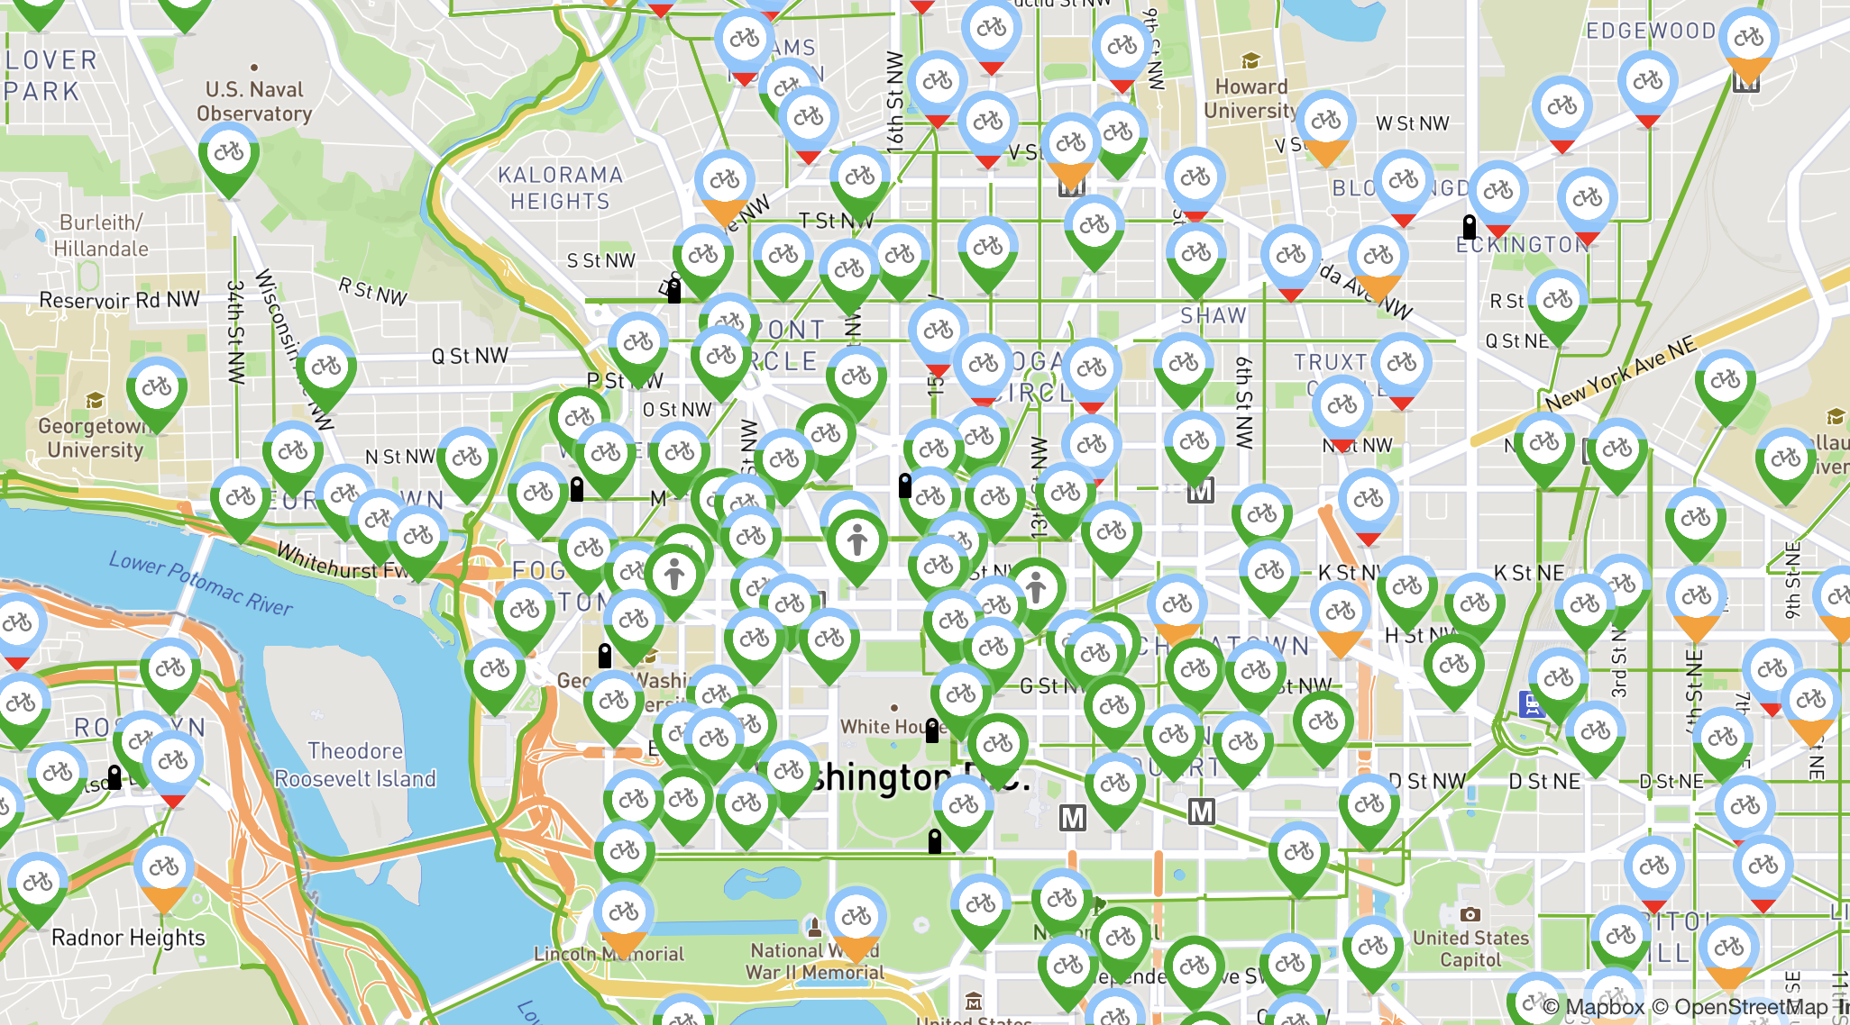
Intro
As bike-share systems gain popularity, companies such as Capital Bikeshare launched membership system to attract users become members. Capital Bikeshare provides bikes for temporary rental around the city. Rates for these services are usually calculated with a standard usage fee based on membership to which rates dependent on duration of usage and mileage traveled.
We are interested in whether there is a difference in biking duration between member and casual users (people who do not hold membership). We are also interested in study whether rider’s trip duration is associated with season.
Notes:
https://secure.capitalbikeshare.com/map/
jane

Slide 3
Methodology
Two-way ANOVA:
Factor A: Membership (Member, Casual user)
Factor B: Season (Spring, Summer, Autumn, Winter)
Number of treatment groups = 8, each of sample size 10.
Total Sample Size: n = 80
Dependent Variable: Trip duration (in seconds)
Member/Spring | Member/Summer | Member/Autumn | Member/Winter
Casual/Spring | Casual/Summer | Casual/Autumn | Casual/Winter
Notes:
jane

Slide 4
Data Collecting
Since the original dataset is too big, we randomly selected 10 data for each group using a random number generator in R.
Sample code:
Q1 <- read.csv("2017Q1-capitalbikeshare-tripdata.csv")
winter <- subset(bike,bike$Date>="2017-01-01" & bike$Date<="2017-03-20")
winter_m <- subset(winter,Member.type=="Member")
sample_1 <- winter_m[sample(1:nrow(winter_m),10,replace=FALSE),]
This code provides 10 random samples for member/winter, we generate other 7 groups with same methodology.
Notes:
Jane
https://s3.amazonaws.com/capitalbikeshare-data/index.html

Slide 5
Data Summary
 | Factor B
Factor A | Winter | Spring | Summer | Autumn | Mean
Member | 712.8 | 633.2 | 616.2 | 651.2 | 653.35
Casual | 1260.5 | 1526.3 | 2234.8 | 3133.3 | 2038.725
Mean | 986.65 | 1079.75 | 1425.5 | 1892.25 | 1346.038
Notes:
jane

Slide 6
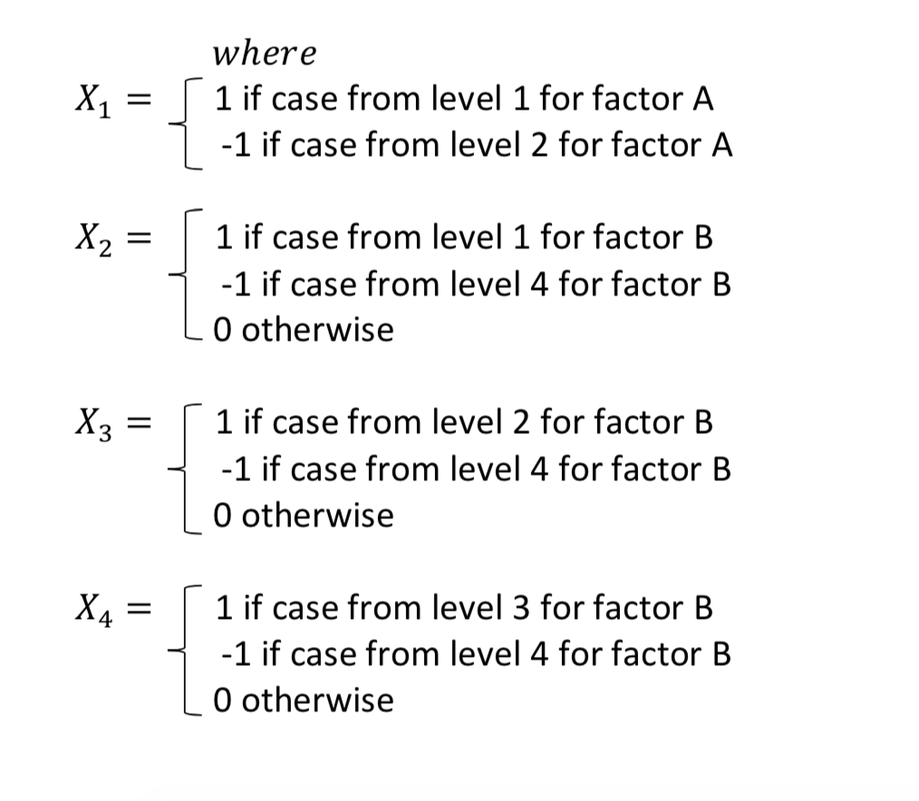
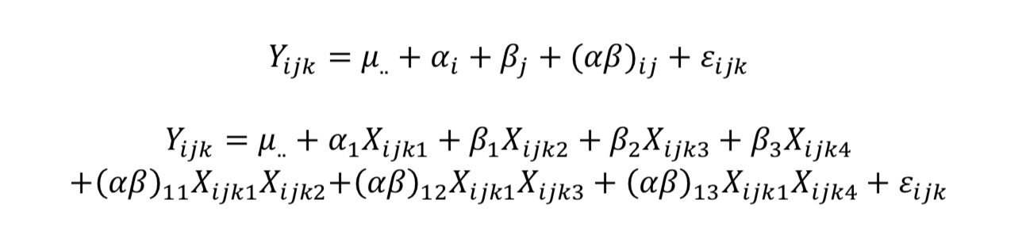
Factor Effects Model

Slide 7
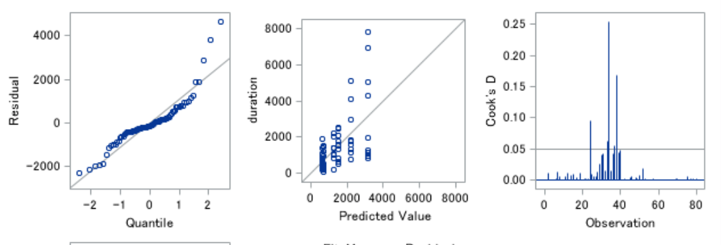
Data Transformation
Lack of normality and constancy of variance → data transformation

Slide 8
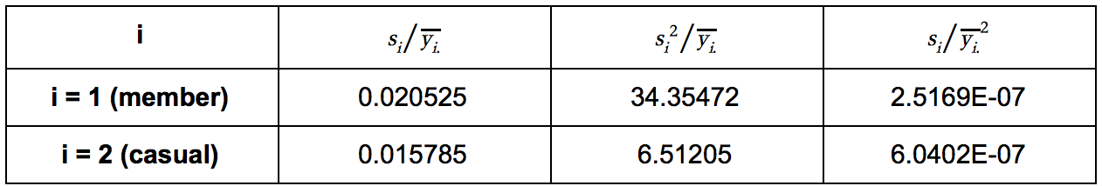
Data Transformation (Cont.)
Use the log transformation since standard deviation to sample mean proportion are the most closest in value:
y' = log y

Slide 9
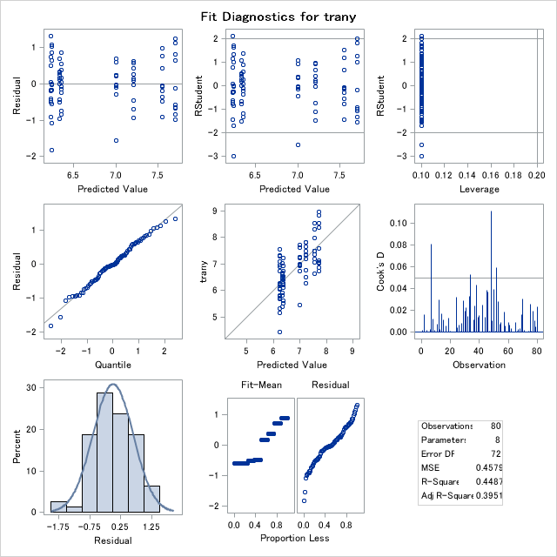
Test for Two Way ANOVA Assumption
From the plots, we can see the data are normally distributed and have similar variance, so the assumptions are satisfied.

Slide 10
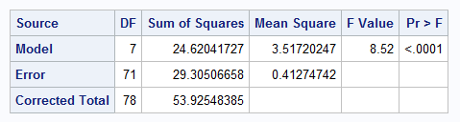
Test for Treatment Means
H₀: All treatments means are equal.
Hₐ: At least one is different.
With F-value =8.52, P-value < 0.0001, we reject null hypothesis, so there are factor effects on the trip duration time.
We then test the interaction effect.
Notes:
naomi

Slide 11
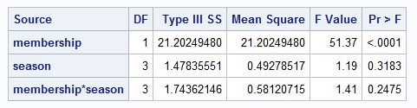
Test for Interaction Effect
H₀: there is no interaction between Factor A and Factor B.
Hₐ: there is interaction between Factor A and Factor B.
With F-value =1.41, P-value =0.2475>0.05, we fail to reject null hypothesis, so there is no significant evidence of interaction effect on the trip duration time.
We then test the main effect.
Notes:
naomi

Slide 12
Test for Main Effects
Factor A:
H₀: the average trip durations are equal for members and casual users.
Hₐ: the average trip durations are not equal for members and casual users.
With F-value =51.37, P-value <0.0001, we reject null hypothesis, so membership is associated with trip duration time.
Factor B:
H₀: the average trip durations are equal for all seasons.
Hₐ: the average trip durations are not equal for all seasons.
With F-value =1.19, P-value =0.3183>0.05, we fail to reject null hypothesis, so we do not have enough evidence to conclude that season has effect on the trip duration time.
Notes:
naomi

Slide 13
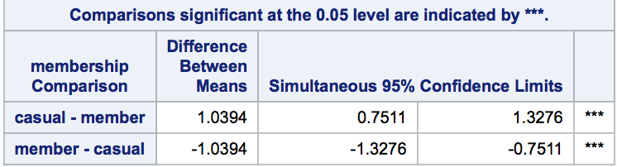
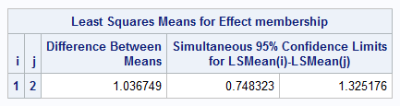
Comparison of means for Membership
Casual users have a higher rank than members, which indicates that amount of time casual riders used the bikes is significantly longer than members, which goes against our initial hypothesis as we thought members take longer trips.
Notes:
Naomi

Slide 14
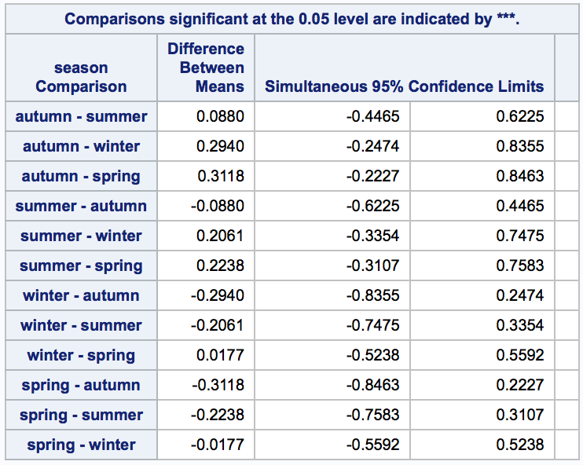
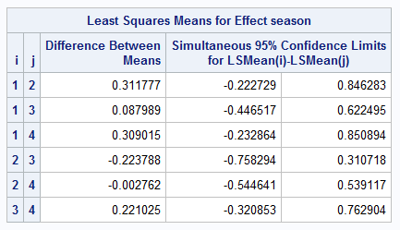
Comparison of means for Season
As we conclude in the main effect test, there is no significant difference among different seasons.

Slide 15
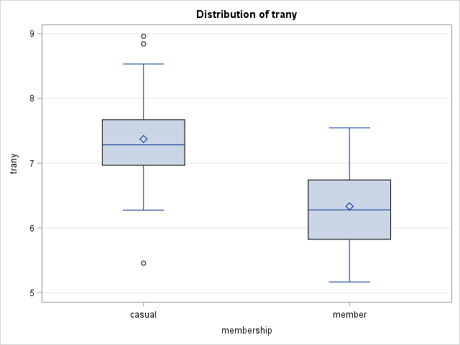
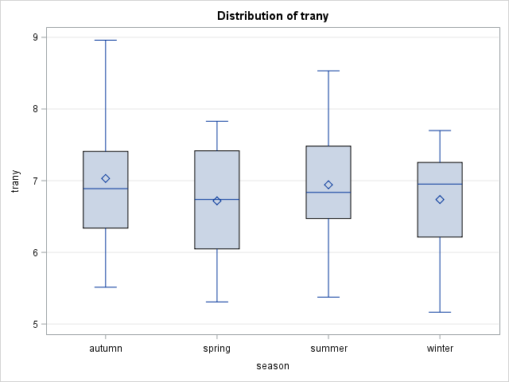
Box Plot verifies our conclusion

Slide 16

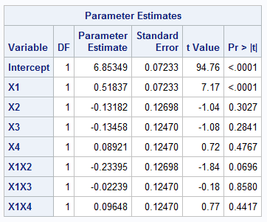
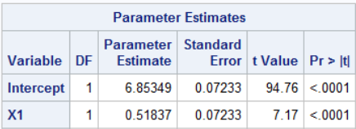
Fit in Regression Model
Full Model:
Reduced Model:

Slide 17
Conclusion
From this test, we conclude there is a significant treatment different; however there was no interaction between membership and season on duration of trip. Nonetheless, membership was significantly associated with trip duration, while season was not associated.
From the member main effect, we find casual users ride significantly longer than members, which is surprising.

